Slide 1
Molecular pathology applied to lung tumours: the experience of a European university hospital
Jean-Christophe B Sabourin
Rouen University Hospital Normandy FRANCE

Slide 2
Disclosure of Relevant Financial Relationships
Dr. JC B Sabourin declares he has
conflicts of interest to disclose
Participation in scientific boards or symposiums for: Amgen, Astellas, AstraZeneca, BMS, Incyte, MSD, Pierre Fabre, Servier
within the past 12 months, which relates to the content of this educational activity and could create a conflict of interest
RDC Nº 96/08 da ANVISA

Slide 3


A case report for introduction
Molecular pathology applied to lung tumours: the experience of a European university hospital

Slide 4
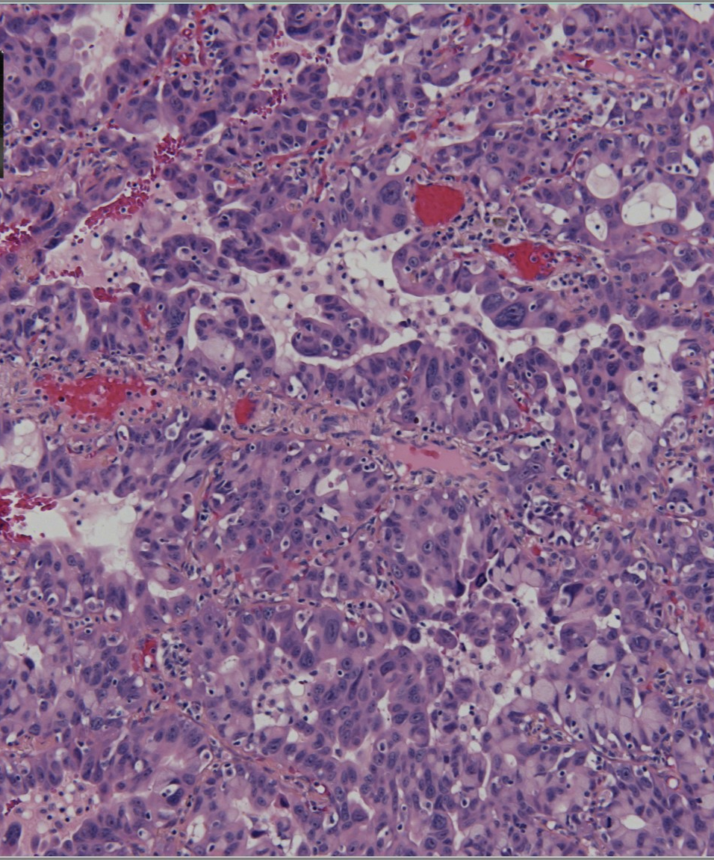
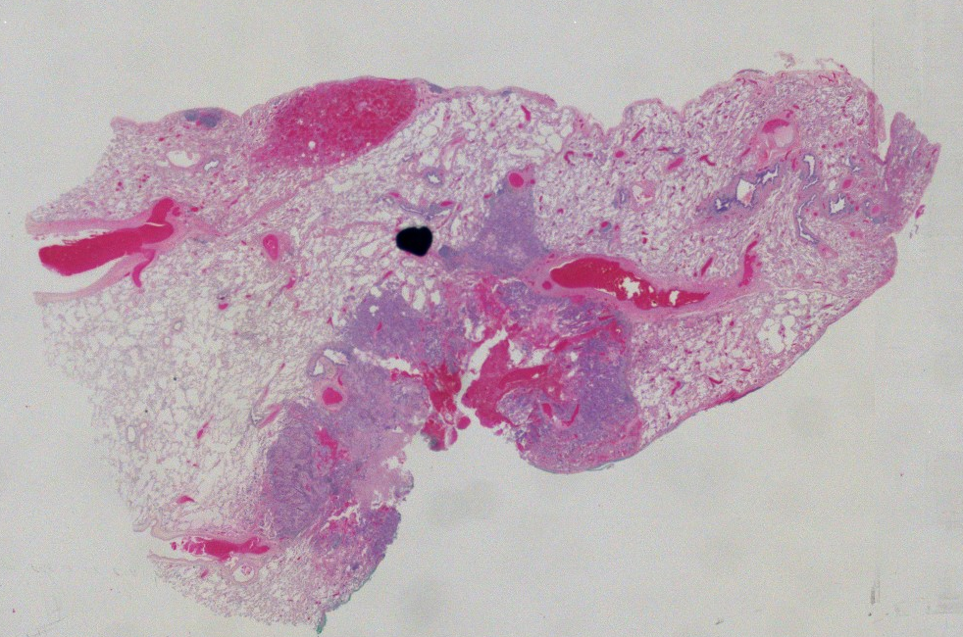
Case report
@CHU Rouen
In 2024, 67-year-old man with no previous medical history
Non smoker
Presented a right lower lobe lesion
Biopsy: ADK, TTF1+
Decision to surgery
Right lower lobe resection
Invasive ADK, acinar type with a micropapillary contingent
pT2aN0MxL0N0V0
IHC performed: TTF1, P40, PDL1, ALK, ROS

Slide 5
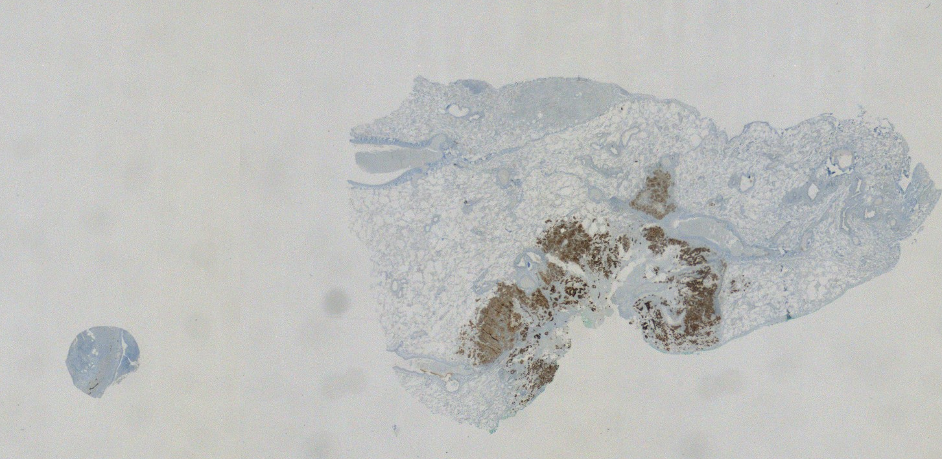
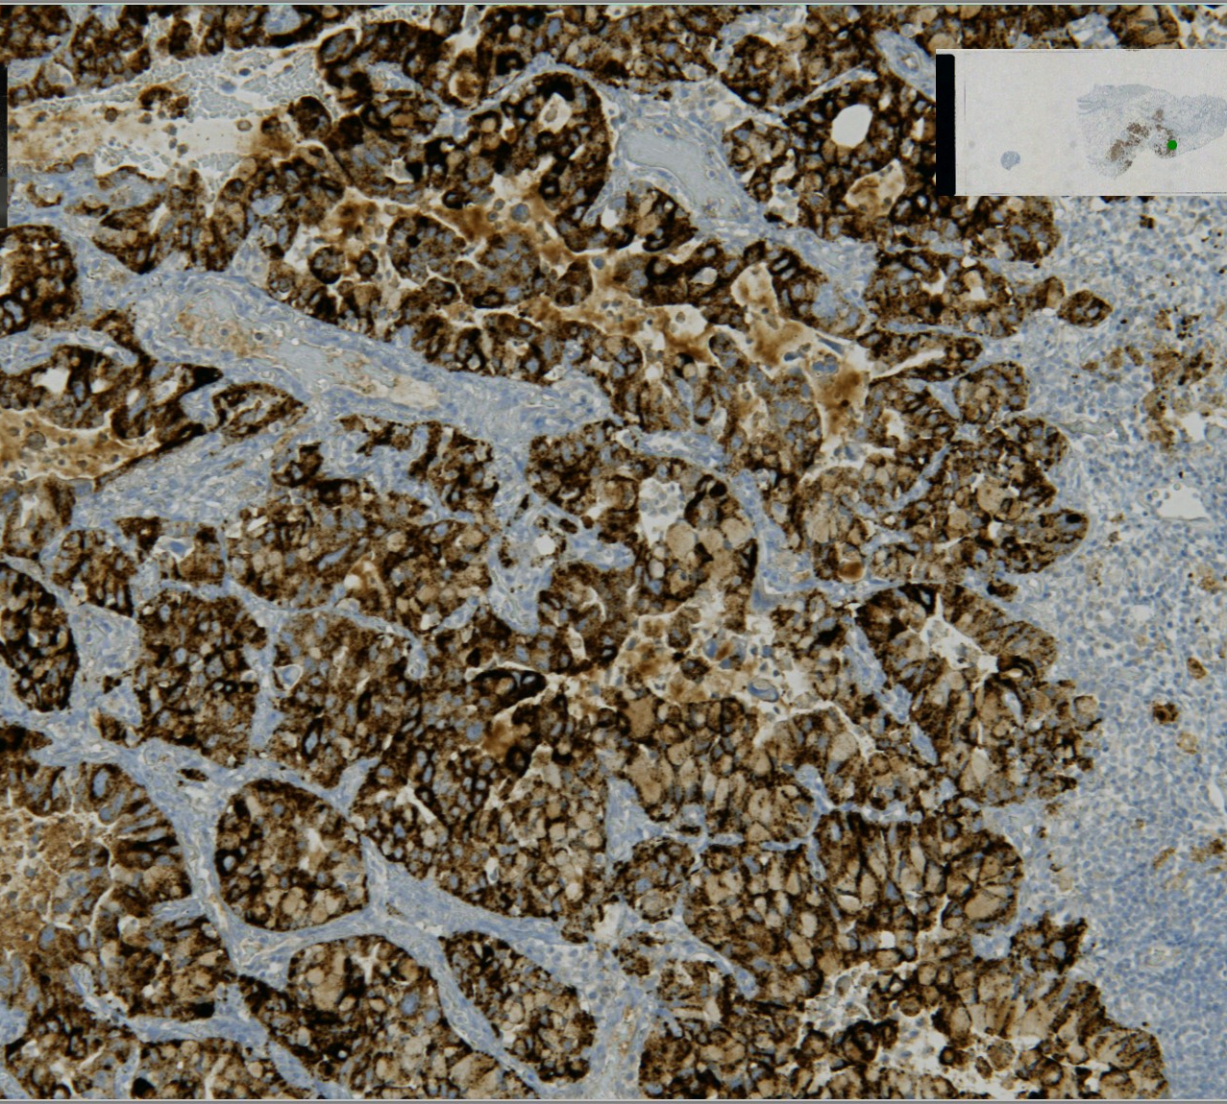
ALK
@CHU Rouen
D5F3, CE-IVD Roche® assay

Slide 6
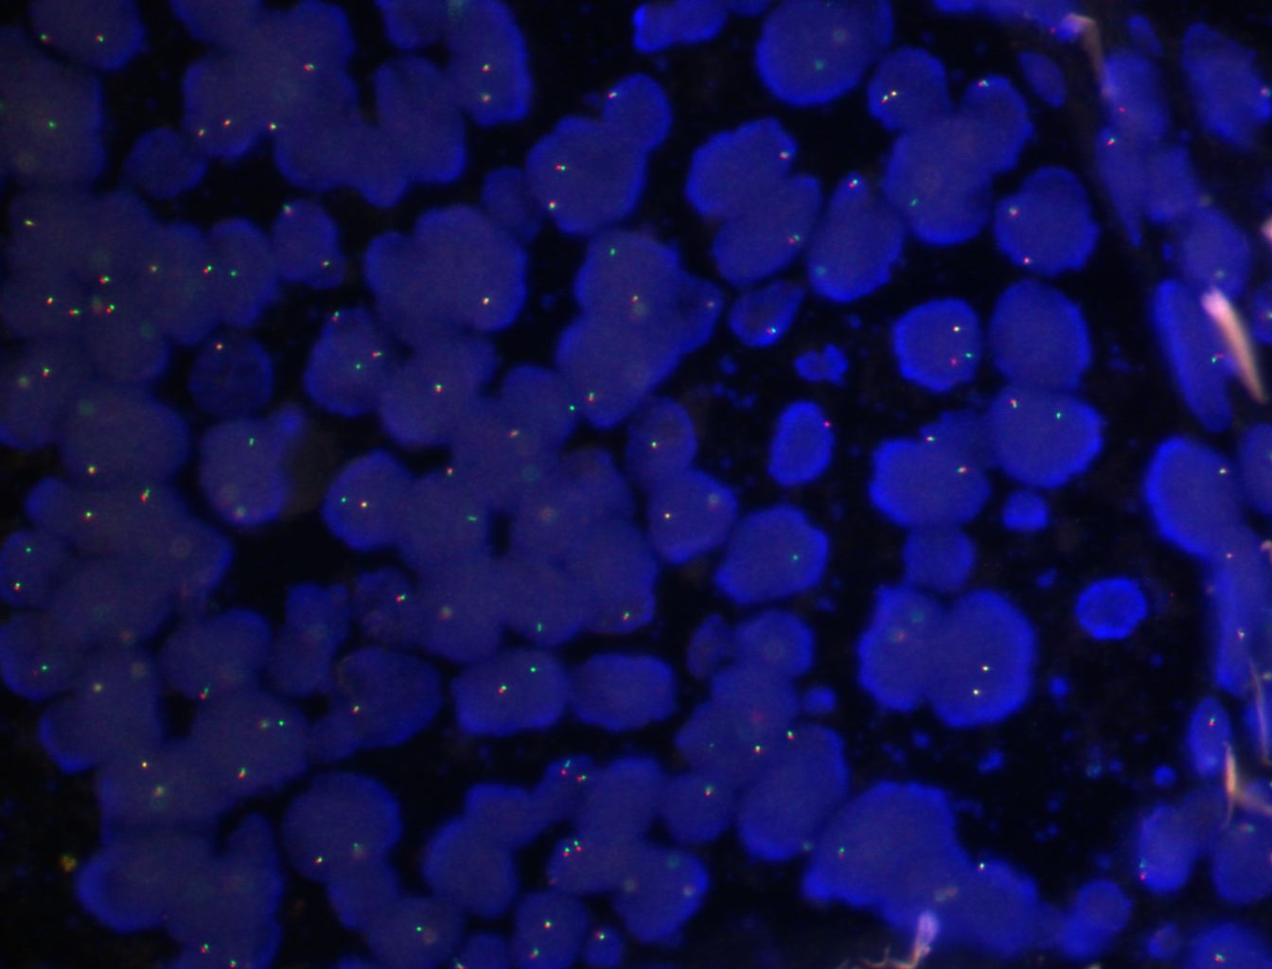
FISH
Absence of ALK rearrangement in cells analysed by FISH (analysis of 50 cells)
NUC ISH (ALK x 2) [50] according to ISCN 2009

Slide 7
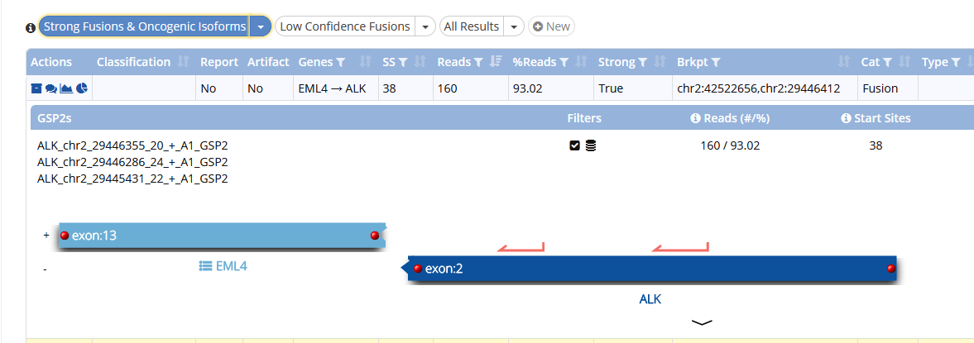
Results NGS
DNA NGS (Multiplicom®): no EGFR KRAS BRAF HER2 mutation
RNA NGS (Archer® FusionPlex lung): fusion between exon 2 of ALK and exon 13 of EML4
This translocation is not visible by FISH: the ALK breakpoint is most often located in intron 19

Slide 8
Why do we test NSCLC?
Molecular pathology applied to lung tumours: the experience of a European university hospital

Slide 9
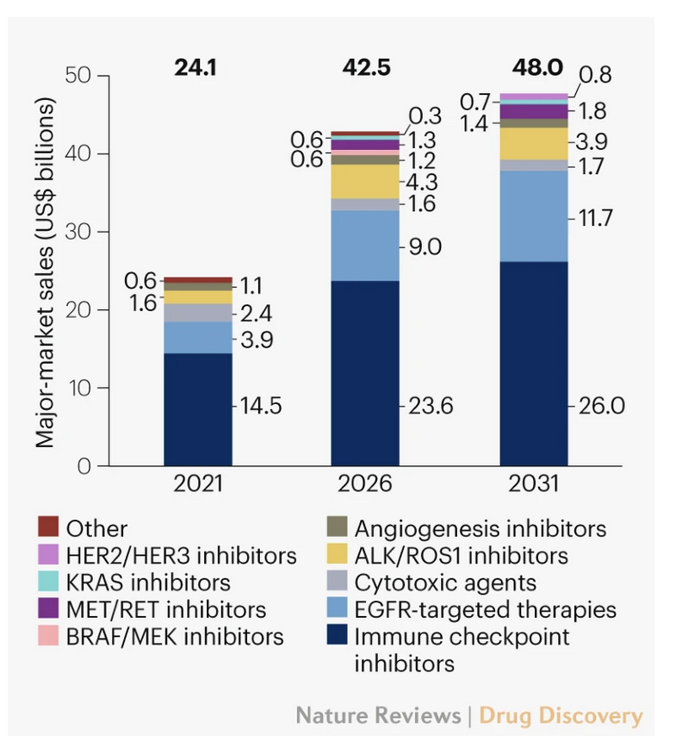
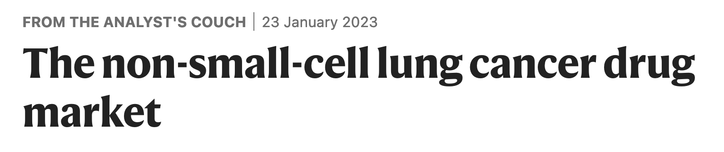
NSCLC: the prototype of personalized medicine
Over the past two decades, NSCLC has evolved into a highly segmented indication defined by tumour histology and molecular aberrations
NSCLC is at the forefront of personalized medicine in oncology with an ever-increasing number of biomarker-driven therapies designed to treat tumours with driver mutations
In addition, immune checkpoint inhibitors (ICIs) have profoundly reshaped the treatment algorithm
US Billion $
Molecular testing for predictive markers and PDL1 protein expression analysis are therefore crucial to guide treatment decisions in NSCLC

Slide 10
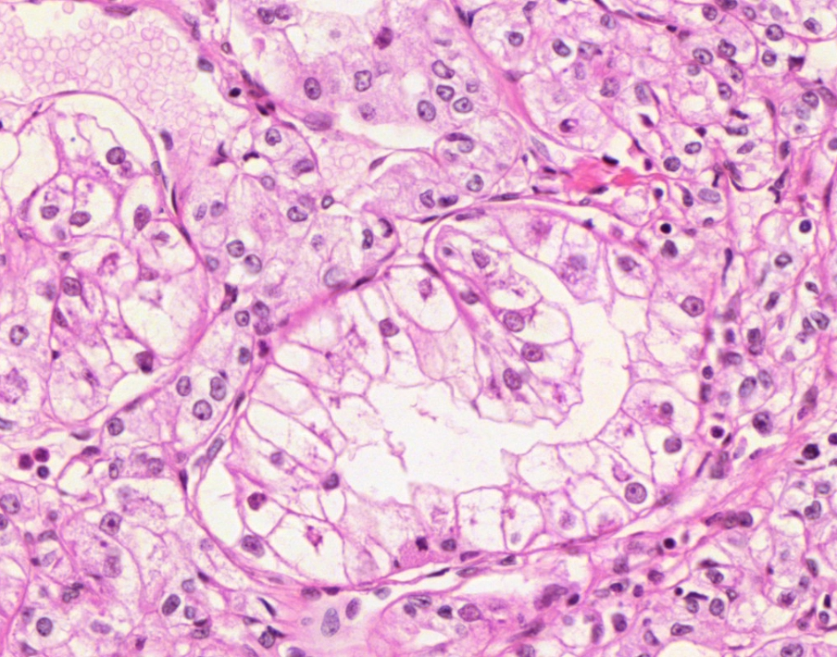
Cancer is a multi-step process
22287 genes
Tumor cell
≈ 100 altered genes
Dans une tumeur : 100 mutations
< 15
initiation,
progression
Tumor surviving
Driver mutations
80
Due to genetic instability
Passenger mutations
The phenotype of a tumor is the reflection of the genetic alterations present in all the tumor cells that compose it!
Sjoblom T et al. Science. 2006 Oct 13;314(5797):268-74
Fearon ER et al. Cell. 1990 Jun 1;61(5):759-67

Slide 11
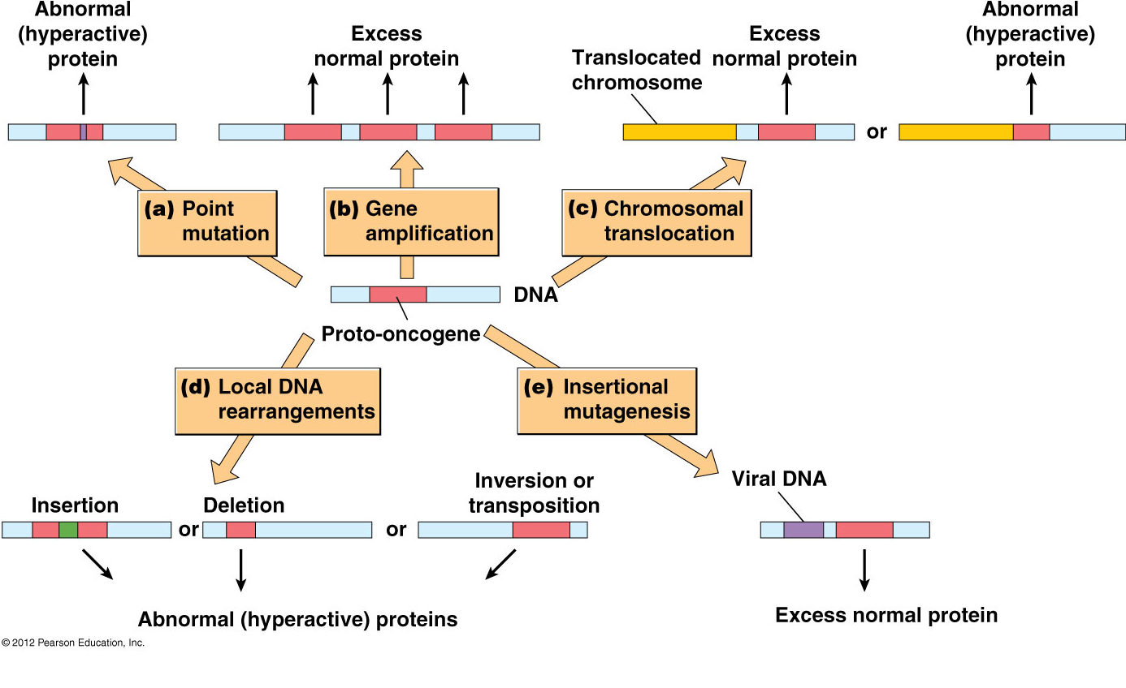
Mechanisms of oncogene alterations
EGFR
KRAS
Chromosome
Translocation
FUSION
ALK
ROS
After Becker's World of the Cell (8th Edition) Jeff Hardin et al, Chapter 24: Cancers cells

Slide 12
Point mutations in lung adenocarcinomas
KRAS (exon 12, including G12D mutation) 32% (13%)
EGFR (exons 18-19-20-21) 10%
BRAF V600 1-5%
HER2 (exon 20) 2-4%
Targeted therapies
Surg Today (2018) 48:1–8 https://doi.org/10.1007/s00595-017-1497-7

Slide 13
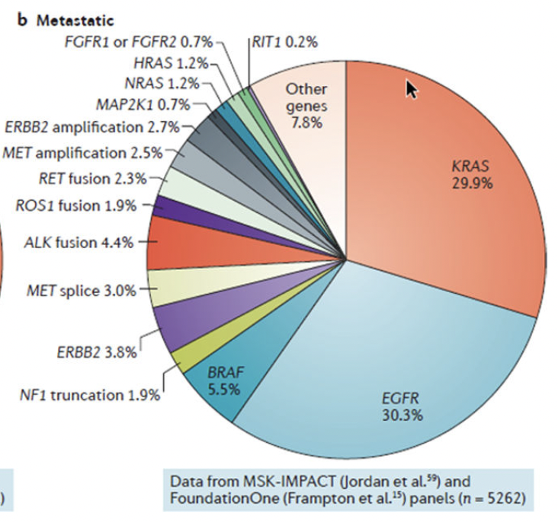
Fusions in lung adenocarcinomas
ALK (5-6%)
ROS (1%)
RET (0,9-1,8%%)
MET exon 14 skipping (2-3%)
NTRK (0,23%)
Targeted therapies
Nat Rev Cancer. 2019 September ; 19(9): 495–509. doi:10.1038/s41568-019-0179-8.

Slide 14
How ?
Molecular pathology applied to lung tumours: the experience of a European university hospital

Slide 15
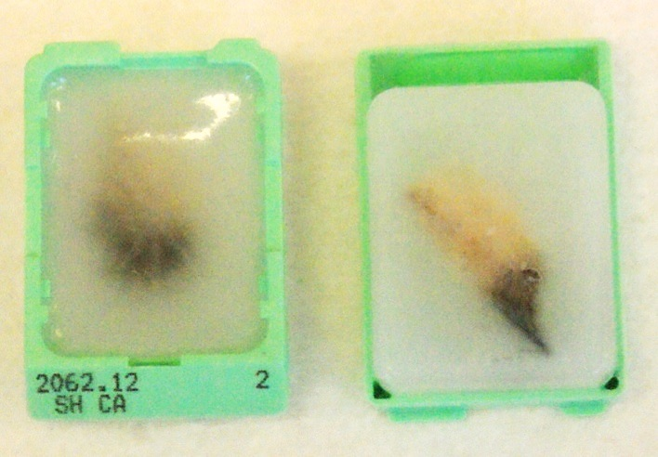
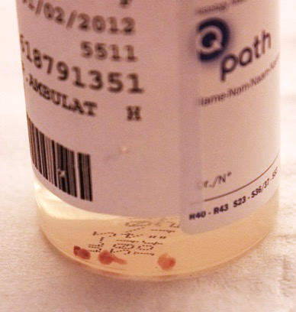
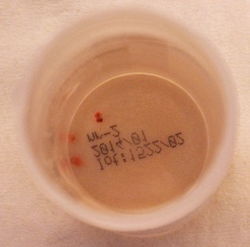
Which material do we used for all these tests: Biopsies and Surgical specimens
FFPE +++
Paraffin Blocks
5µm wide cuttng (10µm for molecular biology)
  HE
  IHC
  FISH
  Mol Biology
1 mm²

Slide 16
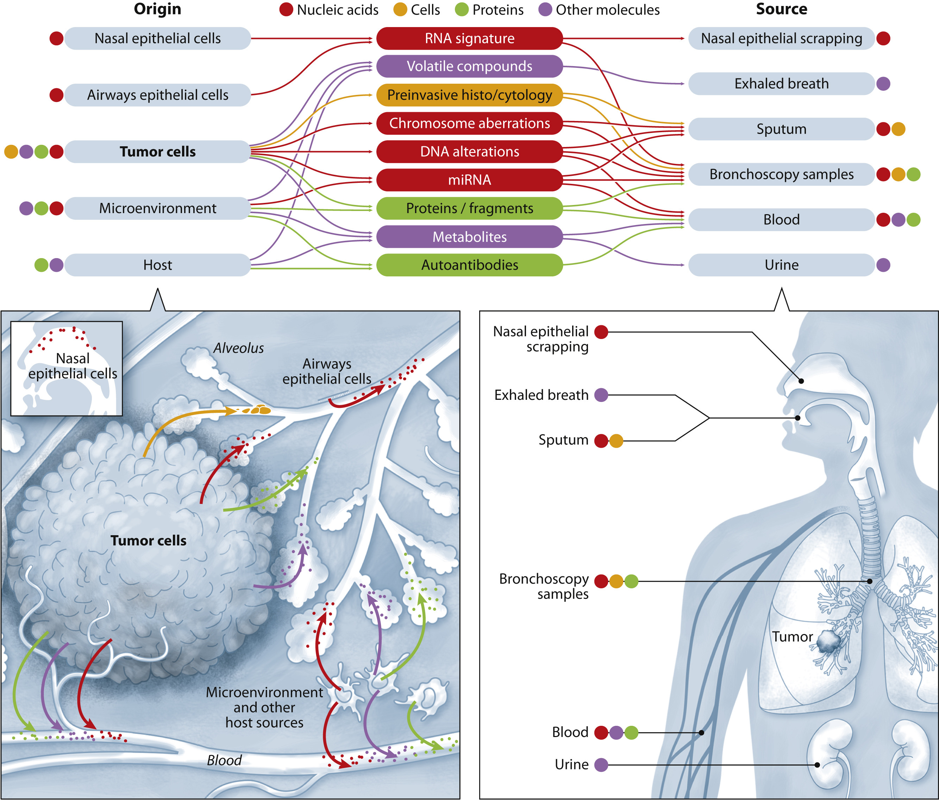
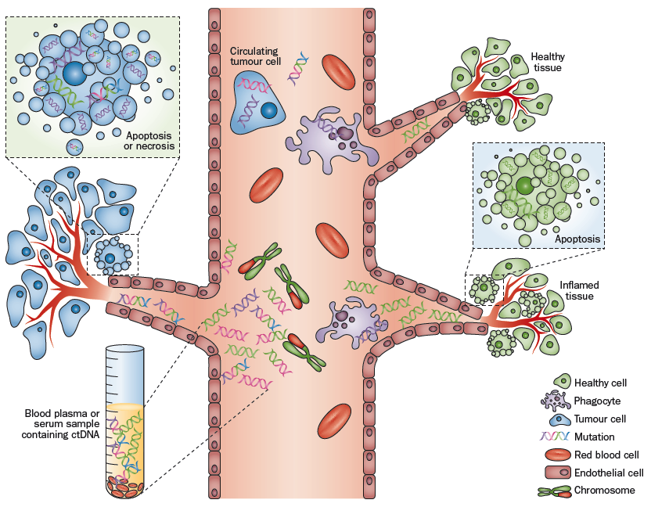
Liquid Biopsy Concept:
From blood to other fluids…
Blood (plasma)
Fluids: - broncho-alveolar lavage
- Pleural effusion…

Slide 17
Immunohistochemistry
Molecular pathology applied to lung tumours: the experience of a European university hospital

Slide 18
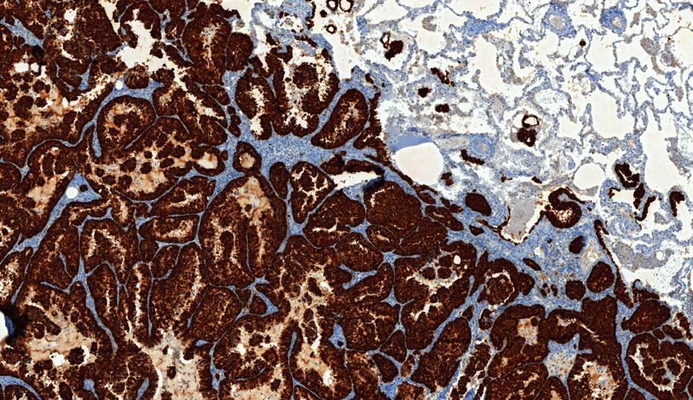
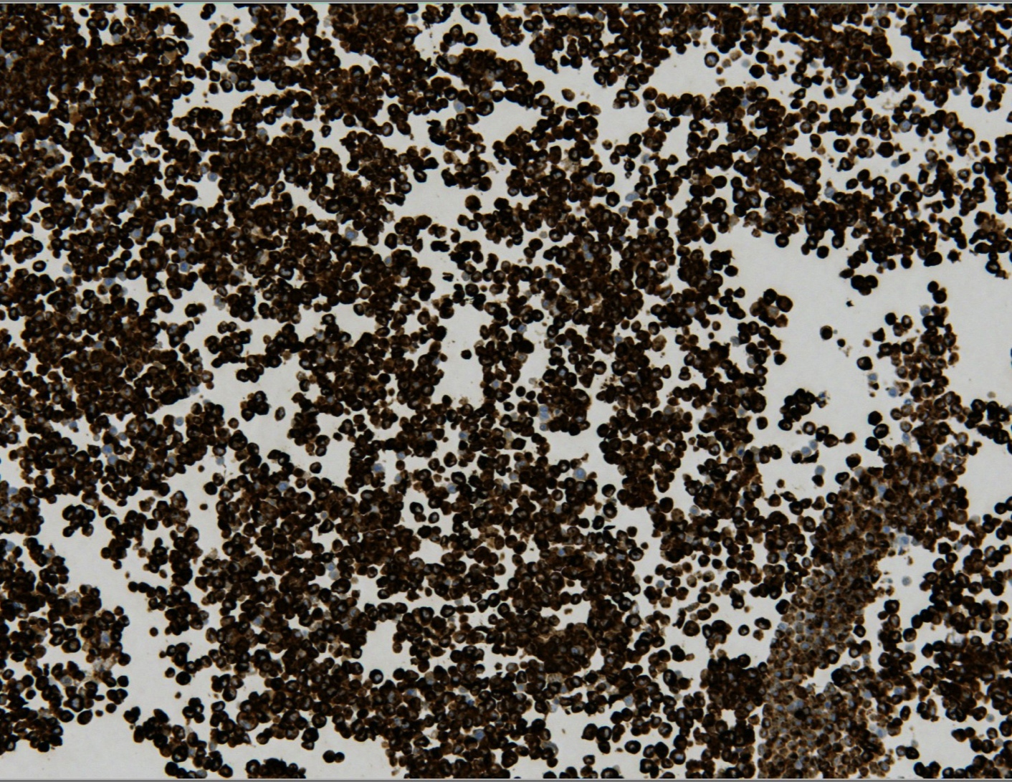
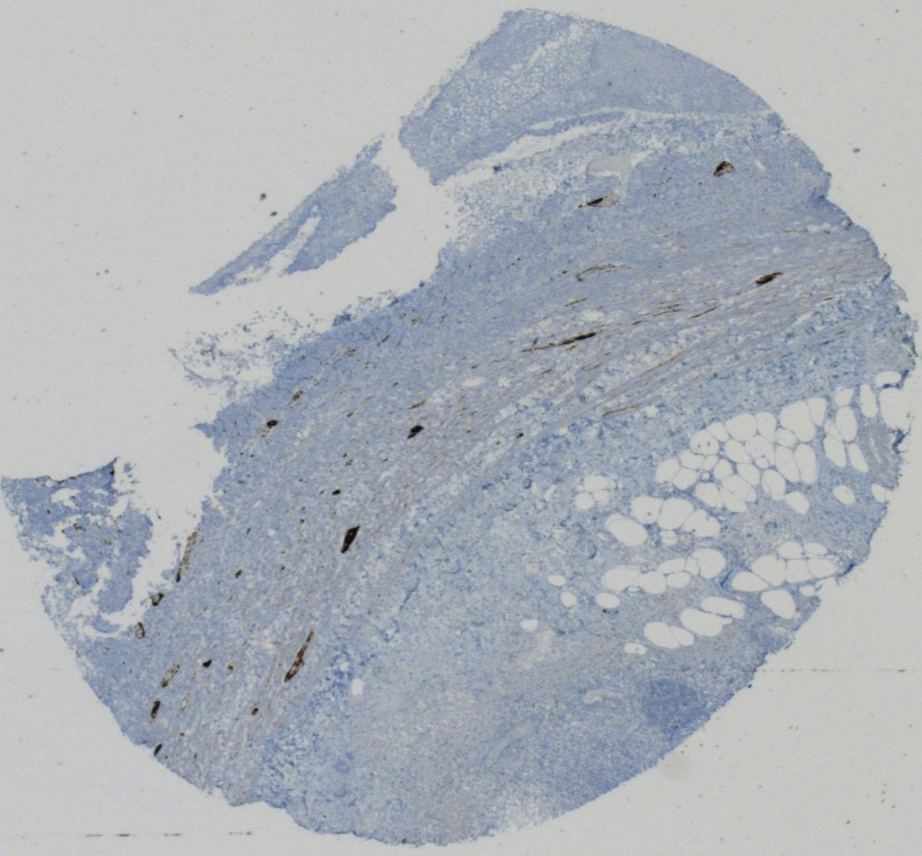
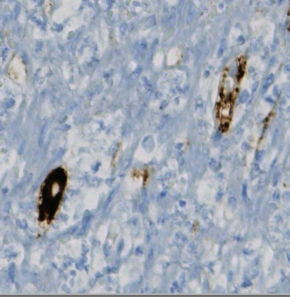
ALK IHC
Targeted therapies against ALK translocated tumors
French recommendations:
if clear cut ALK IHC positivity, no molecular confirmation is needed (FISH or RNA seq)
@Rouen University Hospital
Positive cases (3+), KIT D5F3, CE-IVD Roche®
Positive controls:
Cell line (H2228 ALK + )
or appendix wall

Slide 19
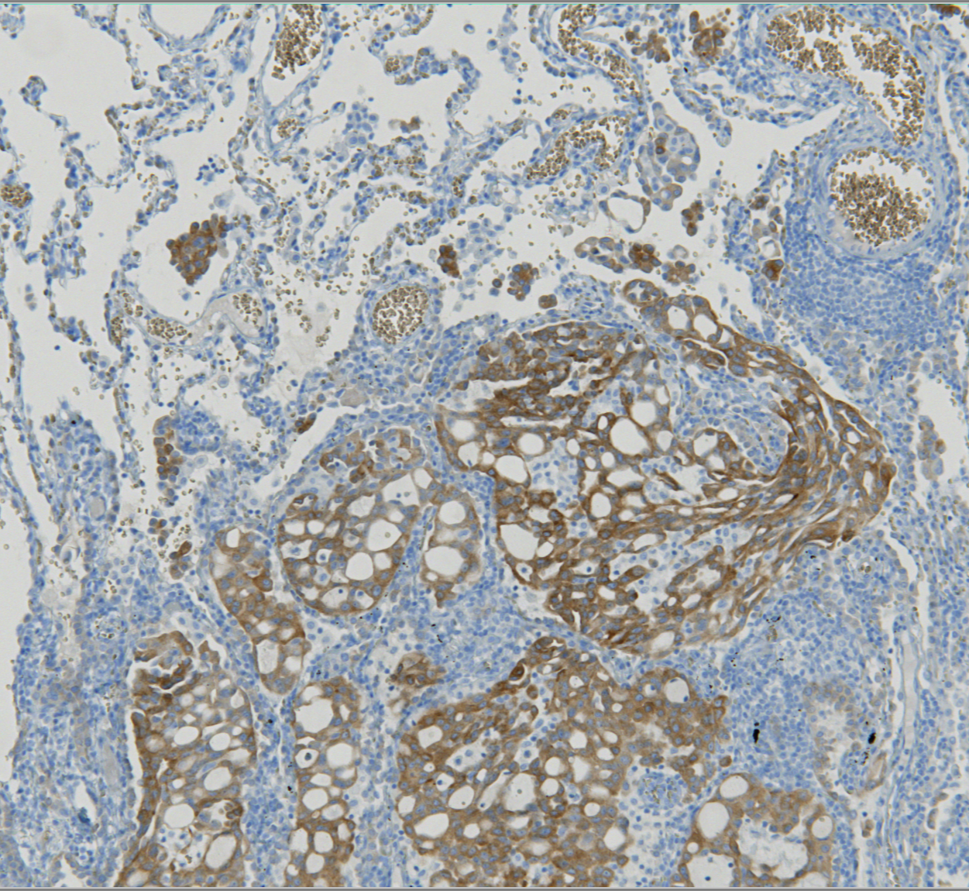
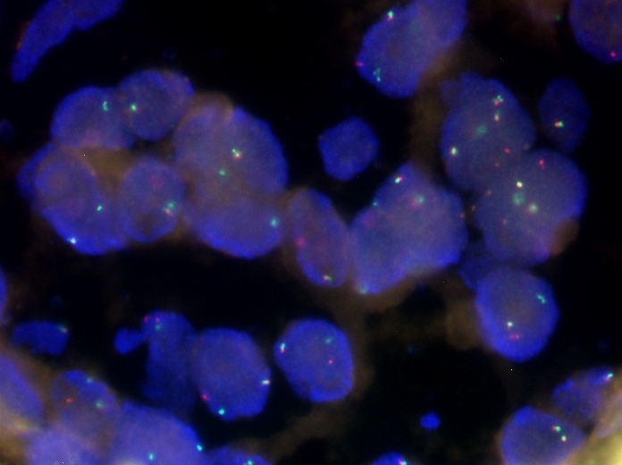
IHC & FISH ROS1
Targeted therapies against ROS1 translocated tumors
Clone D4D6, #3287,
Cell Signaling Technology, Danvers, MA, USA
Sensitivity and specificity for ROS1 detection are 100% & 96.9%
@Rouen University Hospital
SPLIT ROS1 probe
ZytoLight® SPEC ROS1 Dual Color Break Apart Probe
Positive control:
cell line HCC78 ROS1 +
French recommendations: confirmation needed (FISH or RNAseq) after ROS + IHC

Slide 20
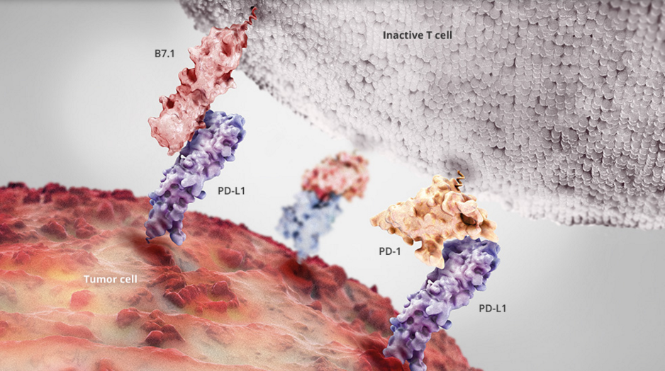
Notes:
Ces dernières années, les avancées thérapeutiques en matière d’immunothérapie toutes pathologies cancéreuses confondues, trustent les podiums dans les plus grands congrès nationaux et internationaux d’oncologie
« Utiliser notre propre système immunitaire pour vaincre le cancer » est le défi que relève actuellement l’immunothérapie.
Évoquée de longue date, cette stratégie thérapeutique est en train de révolutionner la cancérologie. Chercheurs et médecins investissent les pistes possibles pour faire en sorte que notre système de défense s’attaque de façon efficace aux cellules cancéreuses.

Slide 21
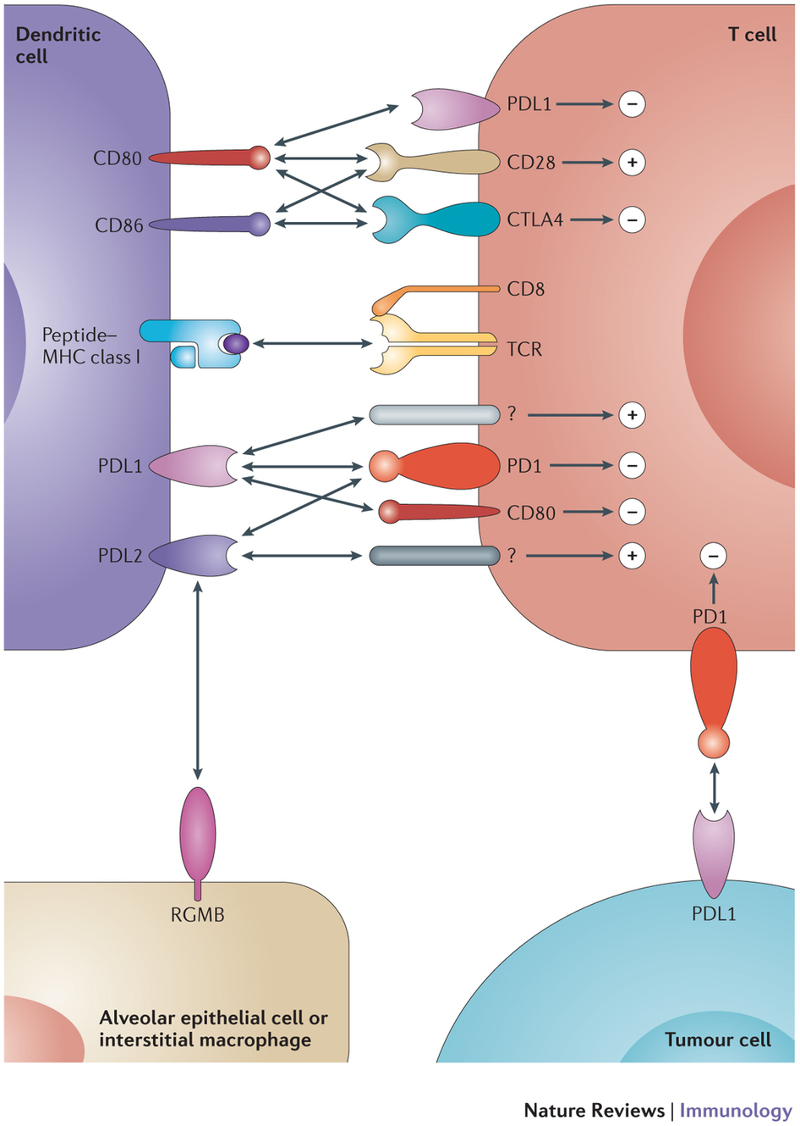
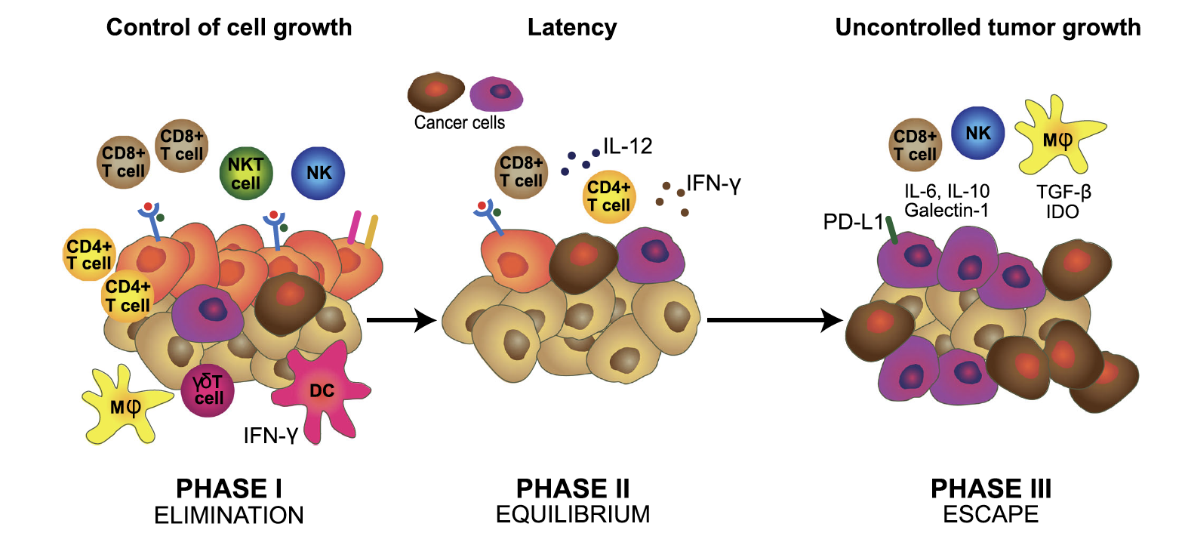
Immune synapse
Immuno surveillance & tumoral escape
Programmed cell death protein 1 (PD-1) CD279
PDCD1 gene
T lymphocytes (CD8), natural killer (NK), some B lymphocytes and some myeloid cells
Programmed death-ligand 1 (PD-L1)
CD274 or B7 homolog 1 (B7-H1)
CD274 gene
Dendritic cells, macrophages, tumor cells
Exhausted T cells
Why is there an escape?
  Tumor cells expressed: IL-10, TGFb, VEGF, PGE2, PDL-1, PDL-2
  And protect themselves from the immune system
Linh T. Nguyen, Pamela S. Ohashi
NATURE REVIEWS 2015
doi:10.1038/nri3790
João Constantino et al Immunol Res (2017) 65:798–810
DOI 10.1007/s12026-017-8931-1

Slide 22
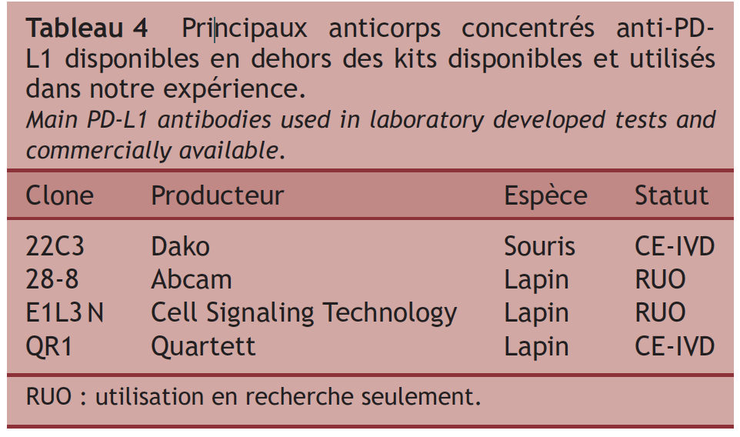
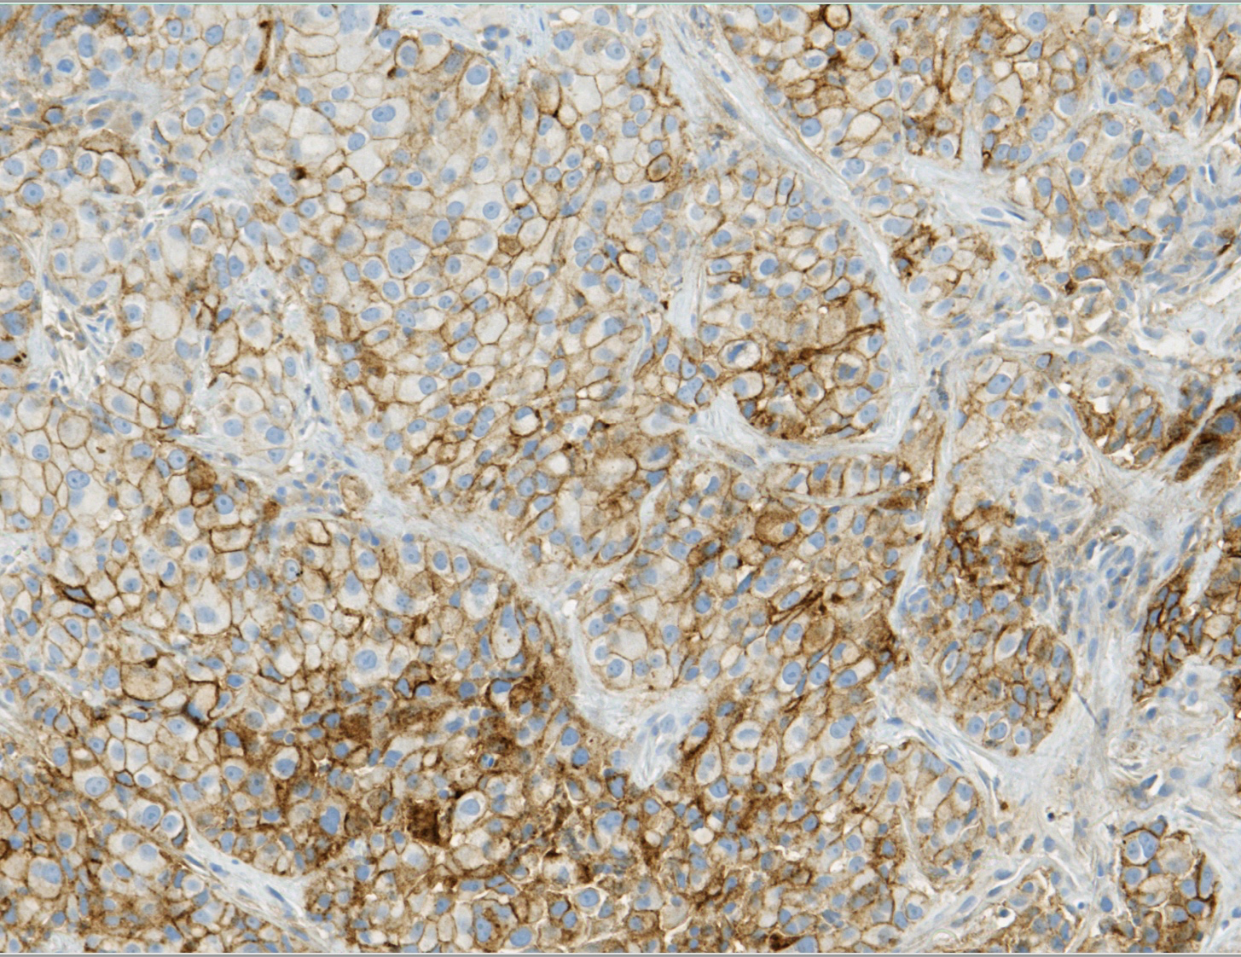
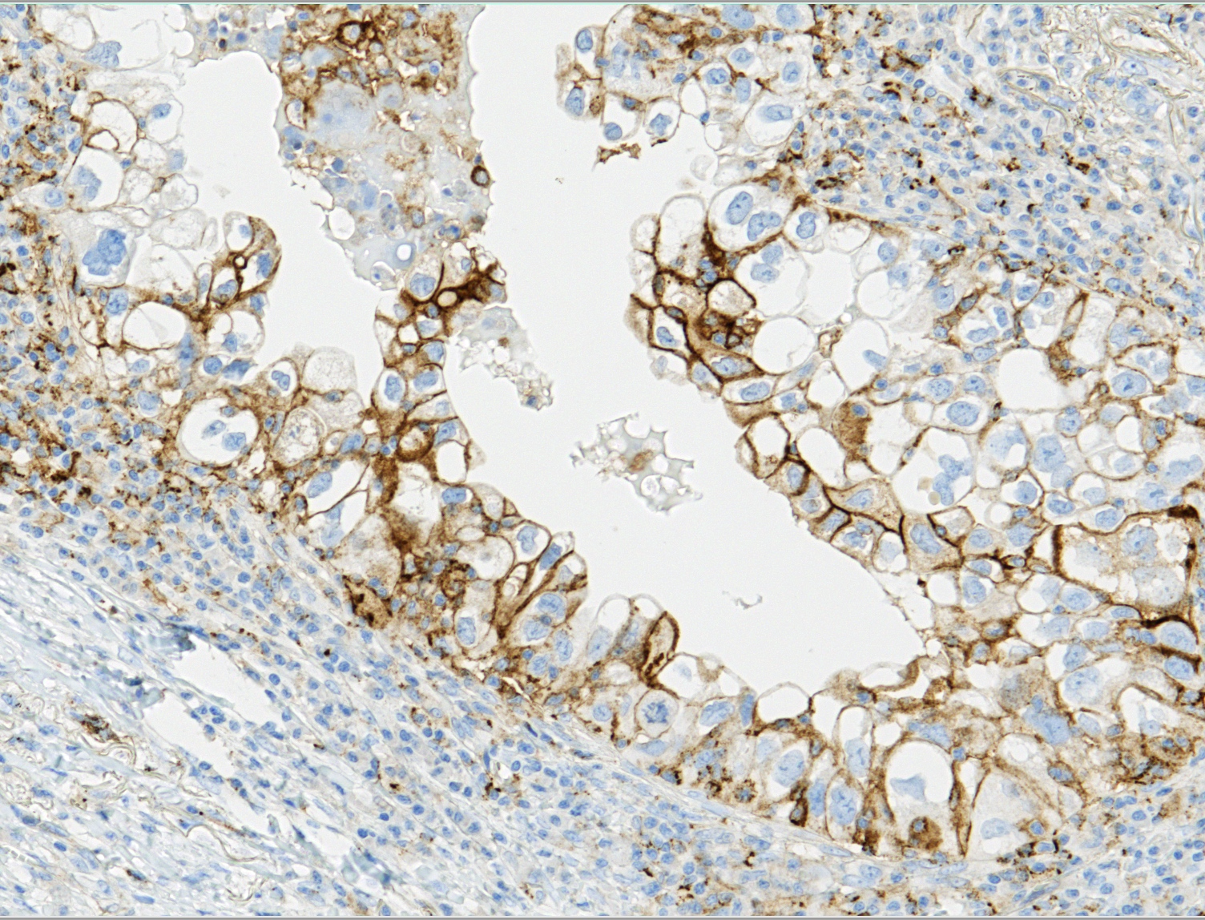
French recommendations for PD-L1 IHC in lung tumors
PD-L1 IHC
QR1
SP263 (ref clone)
http://dx.doi.org/10.1016/j.annpat.2015.11.004

Slide 23
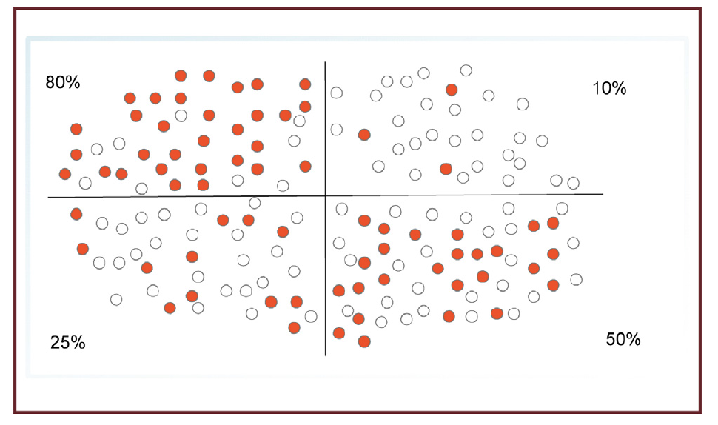
TPS score / percentage of PD-L1+ tumour cells
Tumor proportion score
Number of PD-L1+ tumour cells
TPS =
x100
Number of viable tumour cells
Used in the lung (55-65% positive at ≥1% threshold)
Assessment of PD-L1 expression by immune cells has not been shown to be useful in initial clinical trials
Immunochemical detection of PD-L1
41%
High intensity diffuse membrane labelling of tumour cells

Slide 24
Molecular testing
Molecular pathology applied to lung tumours: the experience of a European university hospital

Slide 25
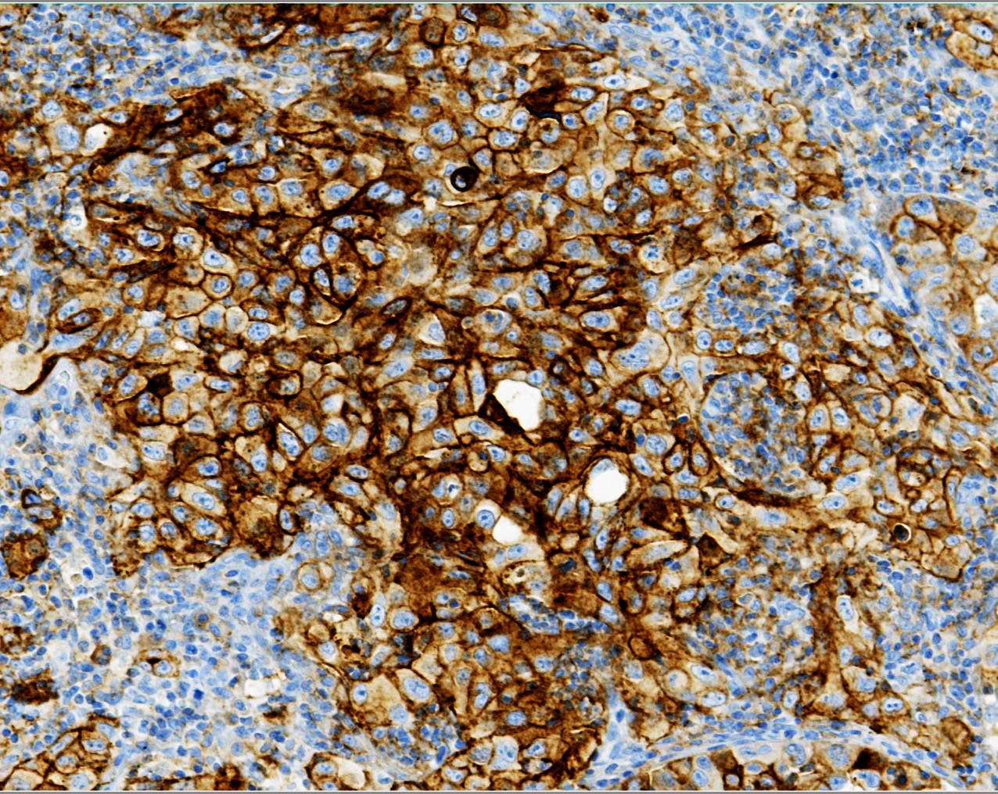
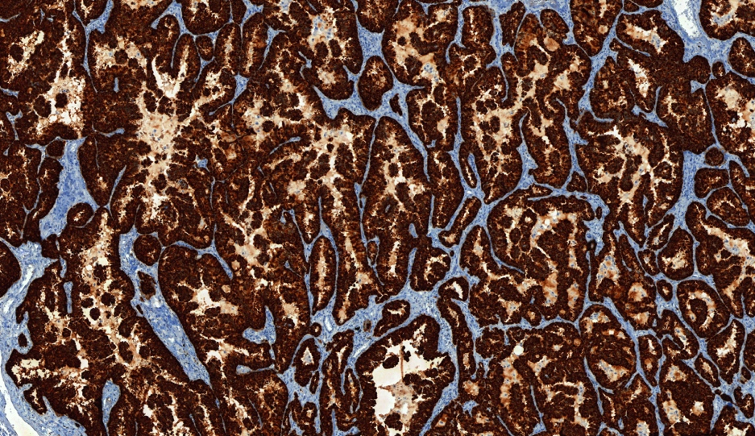
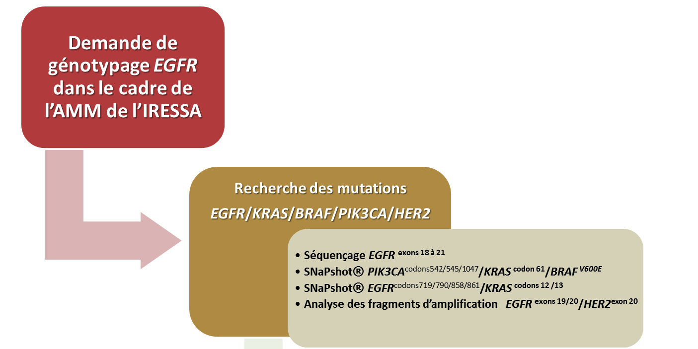
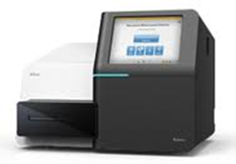

May 2024; Testing NSCLC in Rouen University Hospital, França
On each lung biopsy/specimen: IHC : TTF1, P40, PD-L1
SC
ADK
PD-L1 (E1L3N)
ALK (D5F3)
Molecular testing for targeted therapies
IHC ALK & ROS
SNaPshot EGFR-KRAS-BRAF-HER2
NGS FUSION Archer®
Illumina®
@ Rouen University Hospital

Slide 26

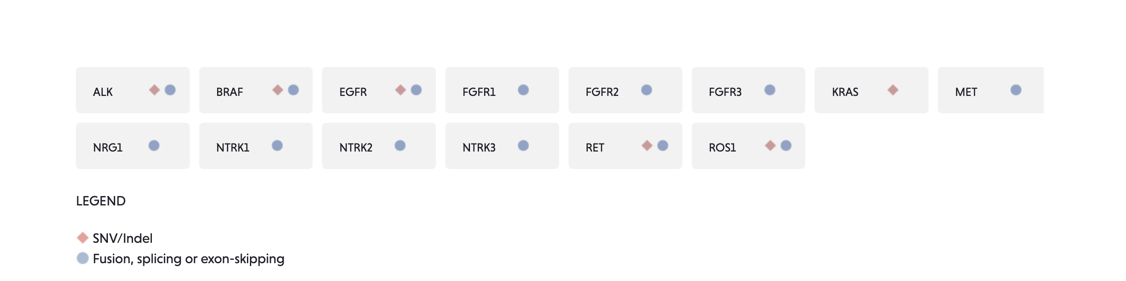


RNA Anchored Multiplex PCR followed by NGS
RNA NGS
For fusions (translocations) and point mutations
@ Rouen University Hospital

Slide 27
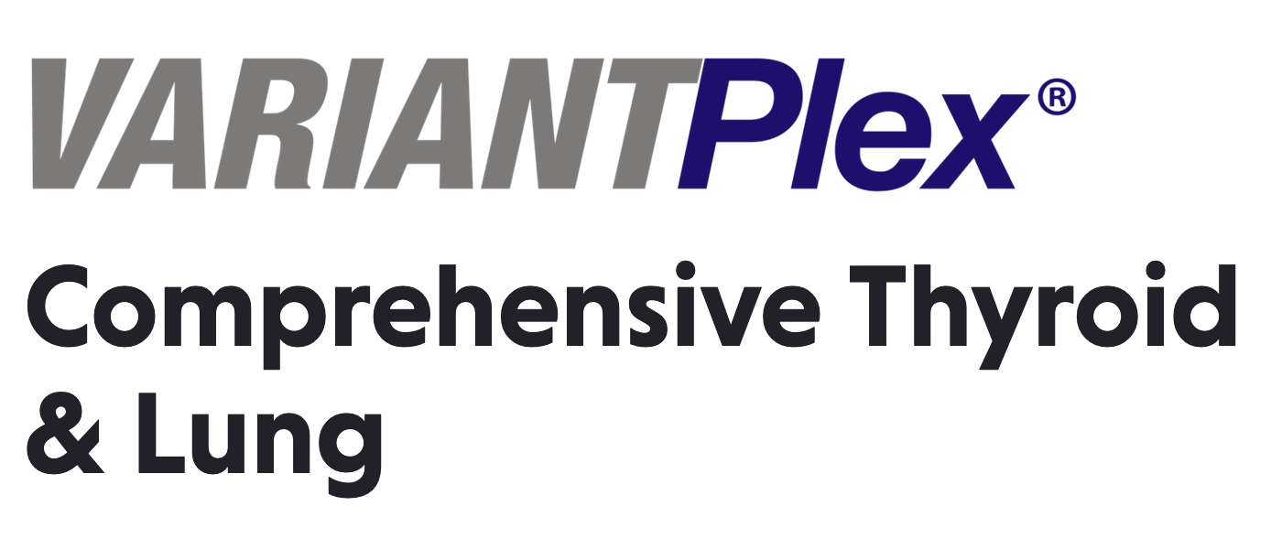
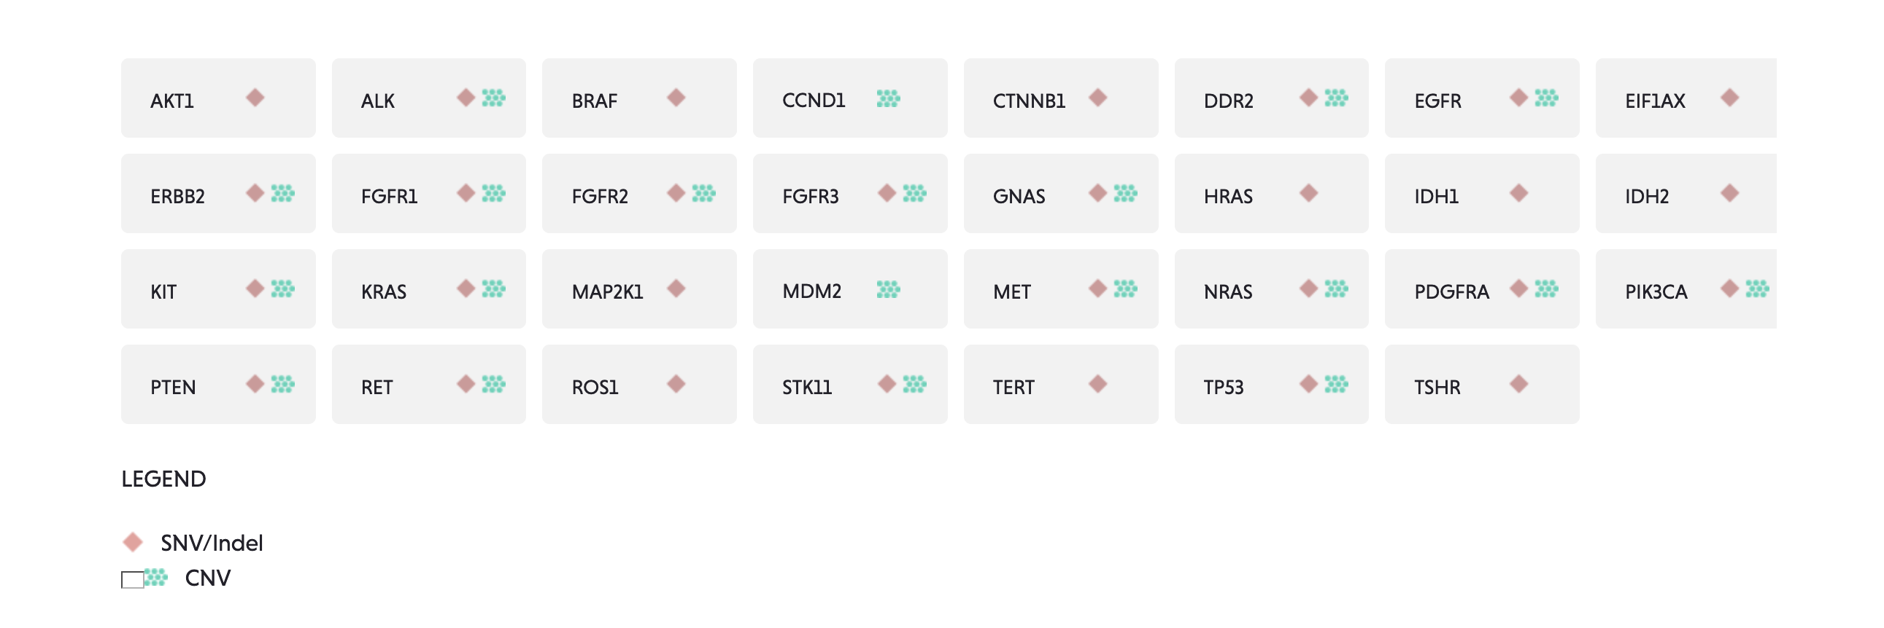
DNA NGS
DNA NGS
For point mutations, amplification, and suppressor-gene
(anti-oncogene) mutations
@ Rouen University Hospital

Slide 28
The French organization
Molecular pathology applied to lung tumours: the experience of a European university hospital

Slide 29

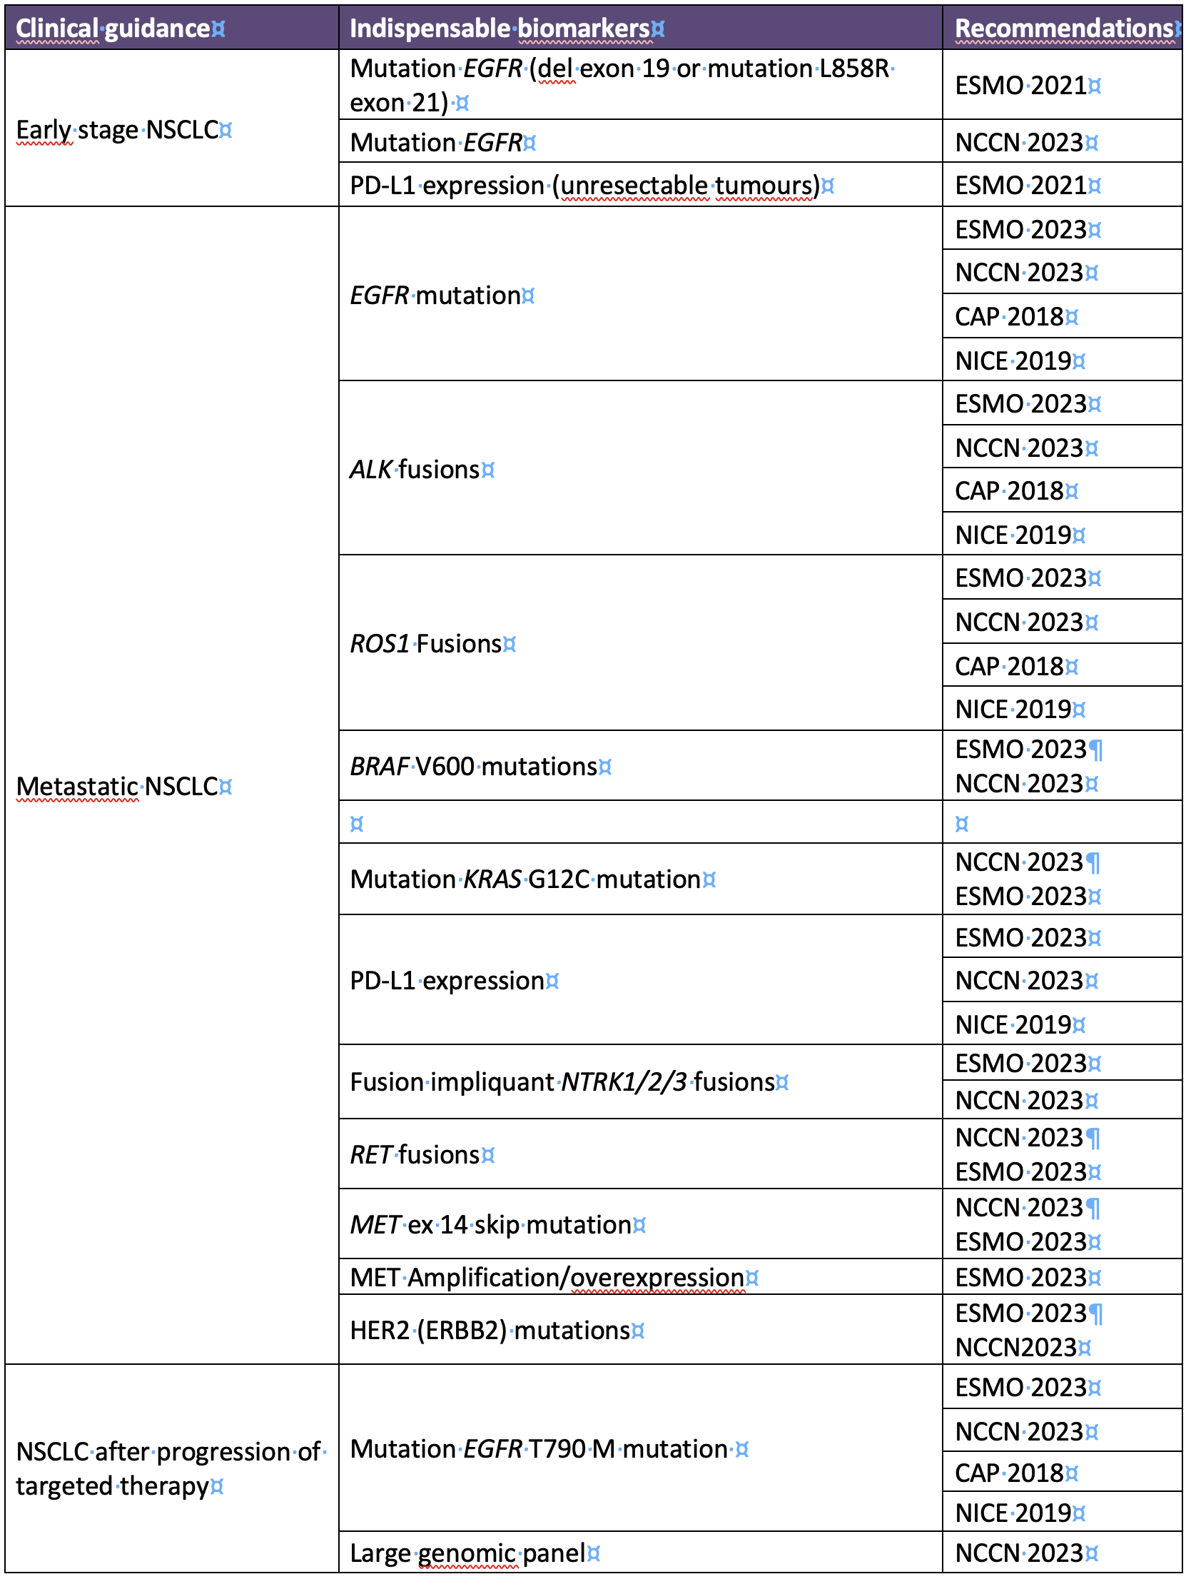
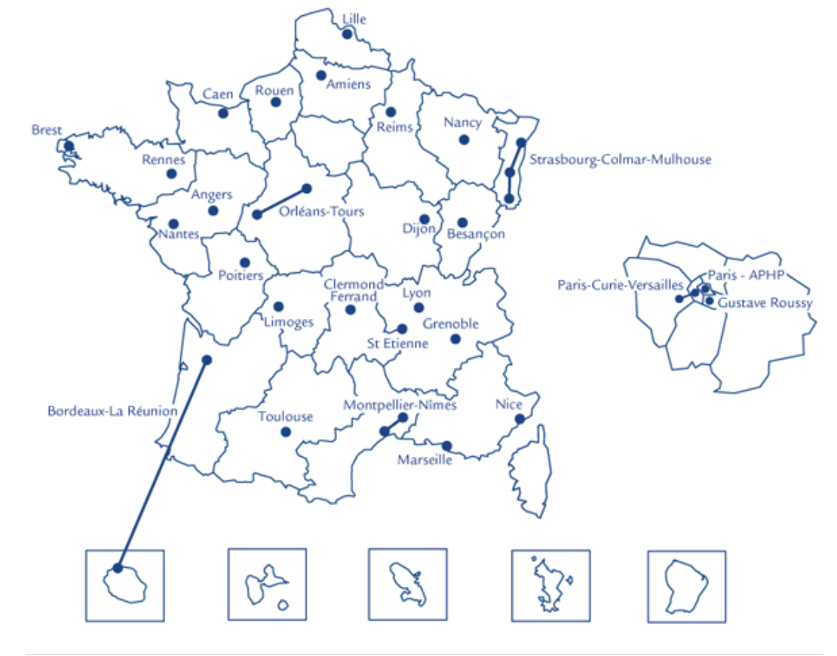
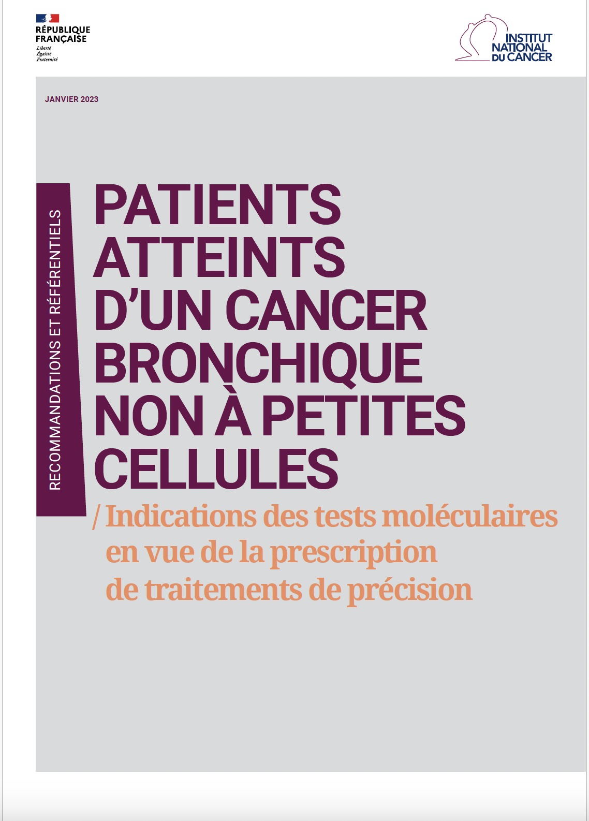
France: 28 cancer molecular genetic platforms
In 2020, these 28 platforms carried out 346,000 tests determining access to targeted therapy for 142,000 patients with NSCLC
Recommendations for testing patients with NSCLC
Updated in 2024

Slide 30
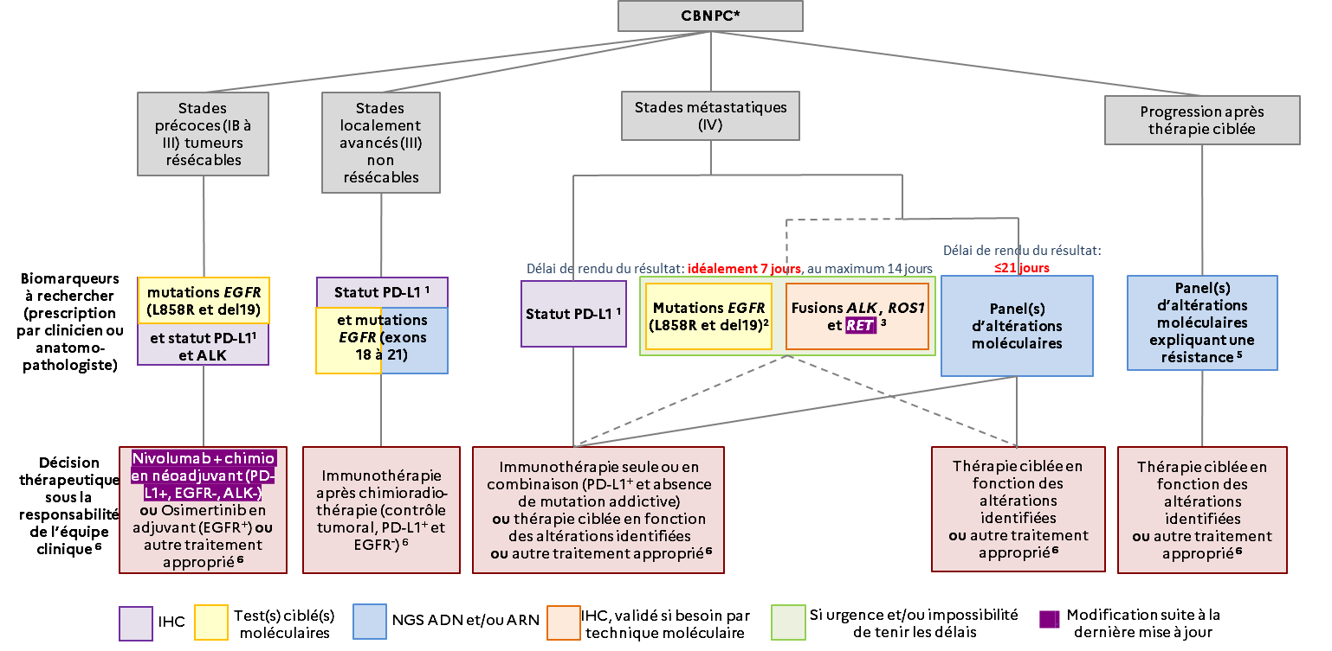
All NSCLC excepted squamous carcinoma arising in a smoker patient
2024 update
https://www.e-cancer.fr/Expertises-et-publications/Catalogue-des-publications/Patients-atteints-d-un-cancer-bronchique-non-a-petites-cellules-indications-des-tests-moleculaires-en-vue-de-la-prescription-de-traitements-de-precision-Synthese

Slide 31
The French exception: free of charge for the patient
Molecular pathology applied to lung tumours: the experience of a European university hospital

Slide 32

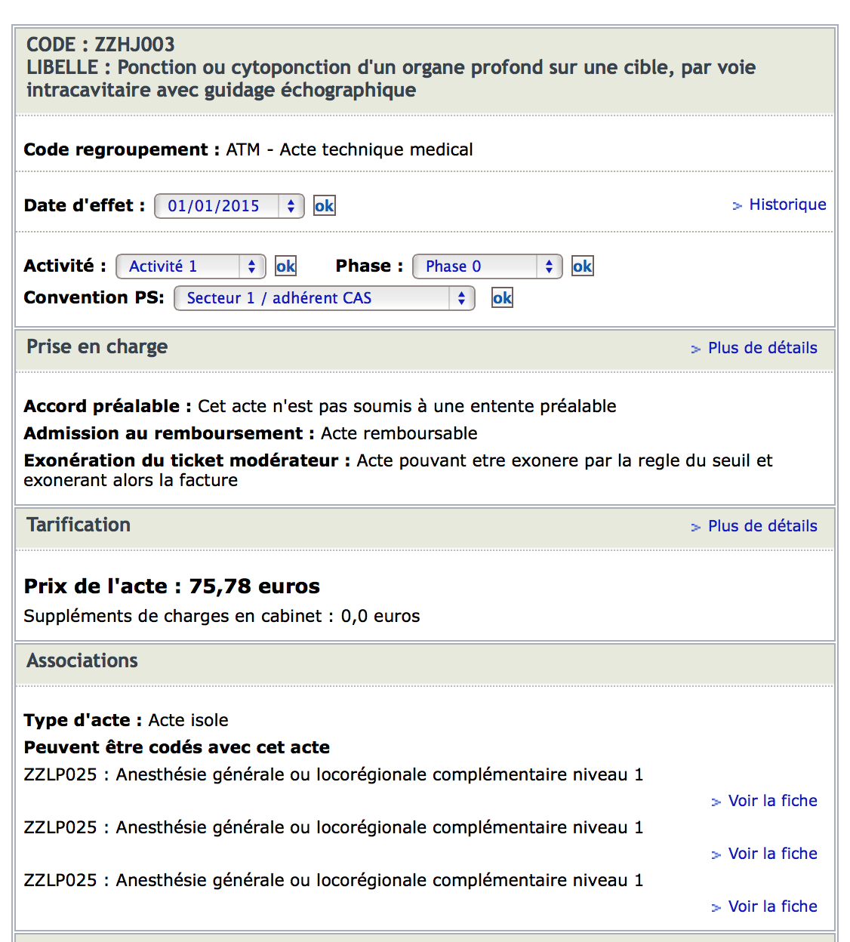
Pathology tests are reimbursed at a flat rate by the French Social Security
For cancer patients, 100% of the cost is cover for:
  - Biopsy examination
  - Surgical specimen examination
  - Immunohistochemistry

Slide 33

Molecular pathology is financed directly by the ministry of health
Free of charge for European citizen (with social health insurance)
Code acte liste complémentaire | Libellé de l'acte de la liste complémentaire/RIHN | Valorisation maximale
N501 | Recherche de la mutation BRAF V600 par technique moléculaire | 116,10 €
N504 | Séquençage EGFR : 4 exons | 315,90 €
N523 | Forfait mutationnel cancer colorectal métastatique (KRAS/NRAS) 6 exons | 440,10 €
N452 | Forfait séquençage haut débit (NGS) < 20 kb | 882,90 €
But half the price indicated is to be paid by the hospital treating the patient
It is forbidden to invoice the patient (who has European health insurance)

Slide 34
Tomorrow: Is AI going to change the paradigm of NSCLC testing ?
Molecular pathology applied to lung tumours: the experience of a European university hospital

Slide 35
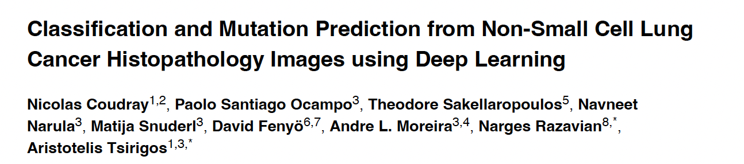
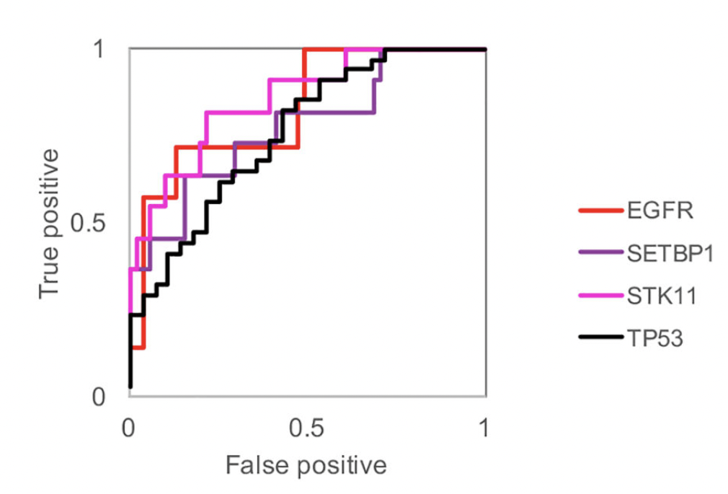
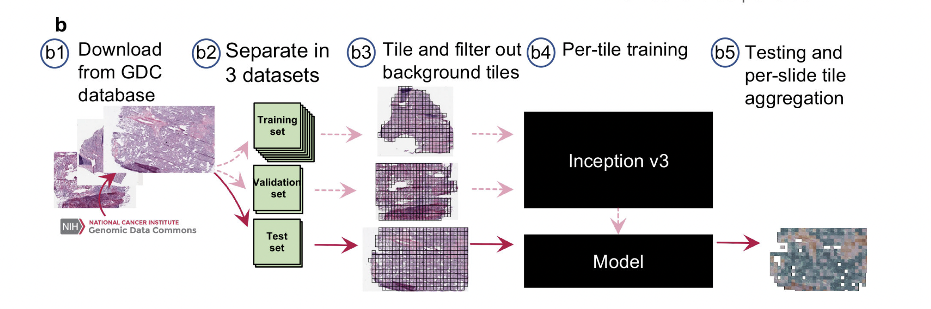
The concept
2018
Gene alteration detected on H&E
They trained a deep convolutional neural network (inception v3) on whole-slide images obtained from The Cancer Genome Atlas to accurately and automatically classify them into LUAD, LUSC or normal lung tissue using a set of respectively 459 and 1175 hematoxylin and eosin stained histopathology whole-slide images

Slide 36
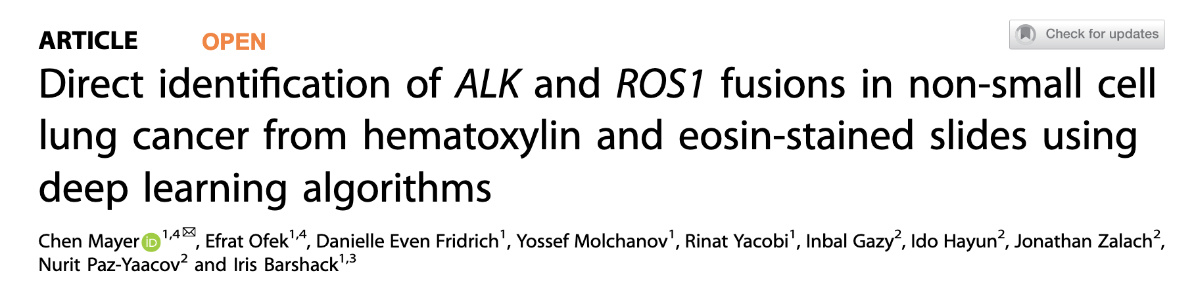
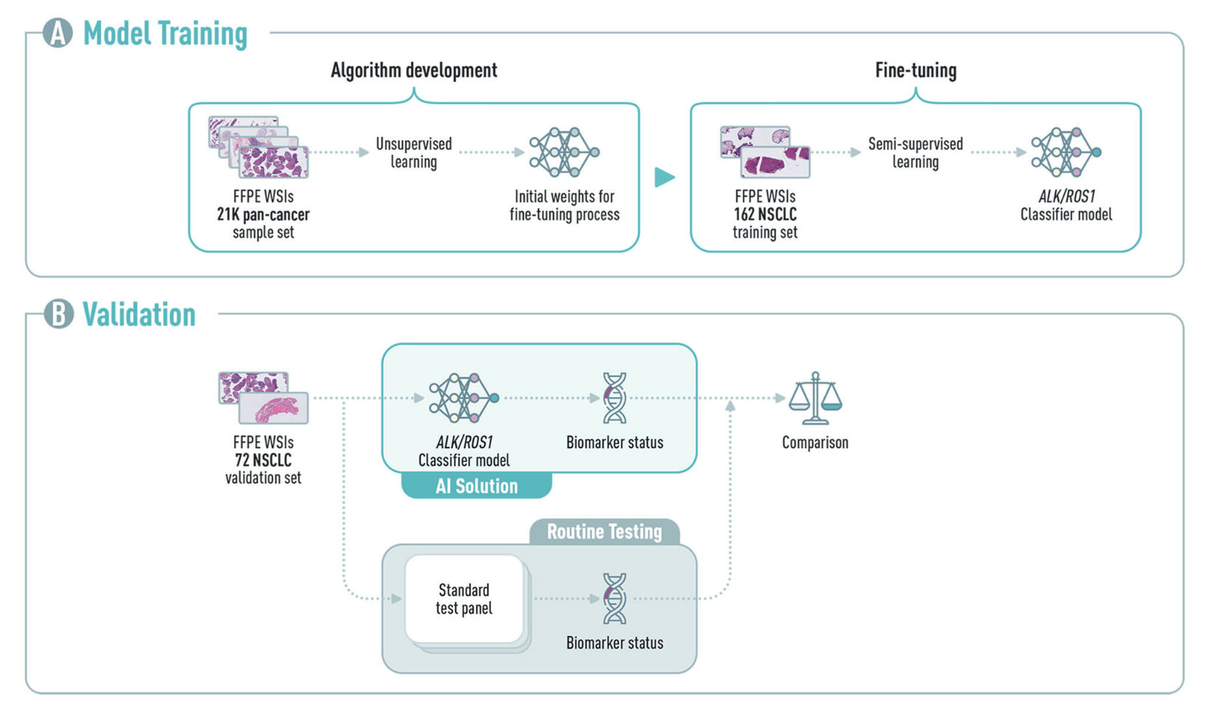
2022
Modern Pathology (2022) 35:1882–1887; https://doi.org/10.1038/s41379-022-01141-4

Slide 37
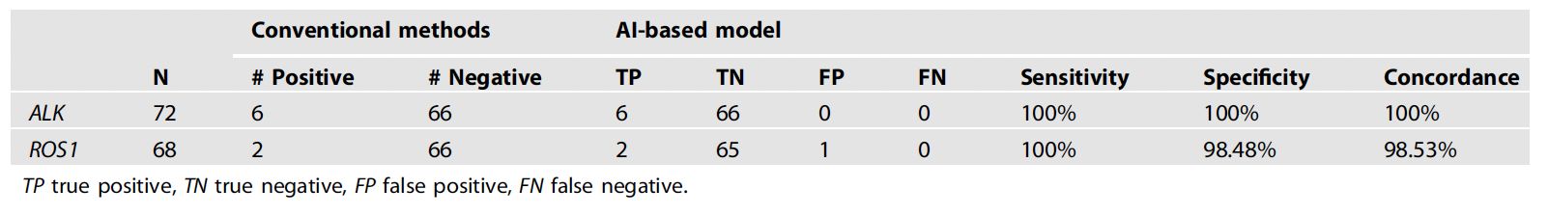


Validation of the ALK/ROS1 classifier on a cohort of 72 lung cancer cases who underwent ALK and ROS1-fusion testing displayed sensitivities of 100% for both genes (six ALK-positive and two ROS1-positive cases) and specificities of 100% and 98.6% respectively for ALK and ROS1, with only one false-positive result for ROS1-alteration
Commercial solution
Modern Pathology (2022) 35:1882–1887; https://doi.org/10.1038/s41379-022-01141-4

Slide 38
Where are we now ?
Molecular pathology applied to lung tumours: the experience of a European university hospital

Slide 39
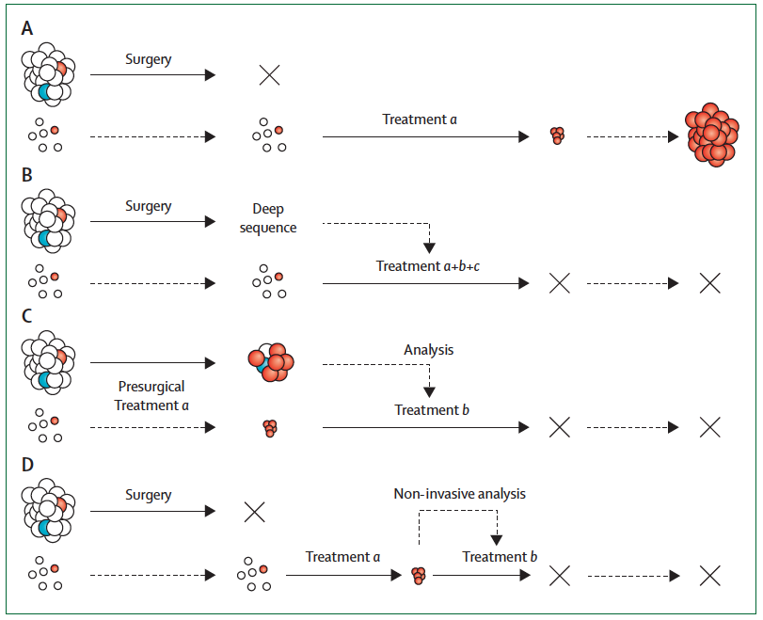
In 2024, where are we for lung carcinoma testing?
2012
yesterday
EGFR
KRAS G12C
ALK
ROS
MET
RET
NTRK
And more…
NGS
today
cDNA : T790M EGFR
C797S EGFR
2024
Nicholas C Turner NC et al. Lancet Oncol 2012; 13: e178–85

Slide 40
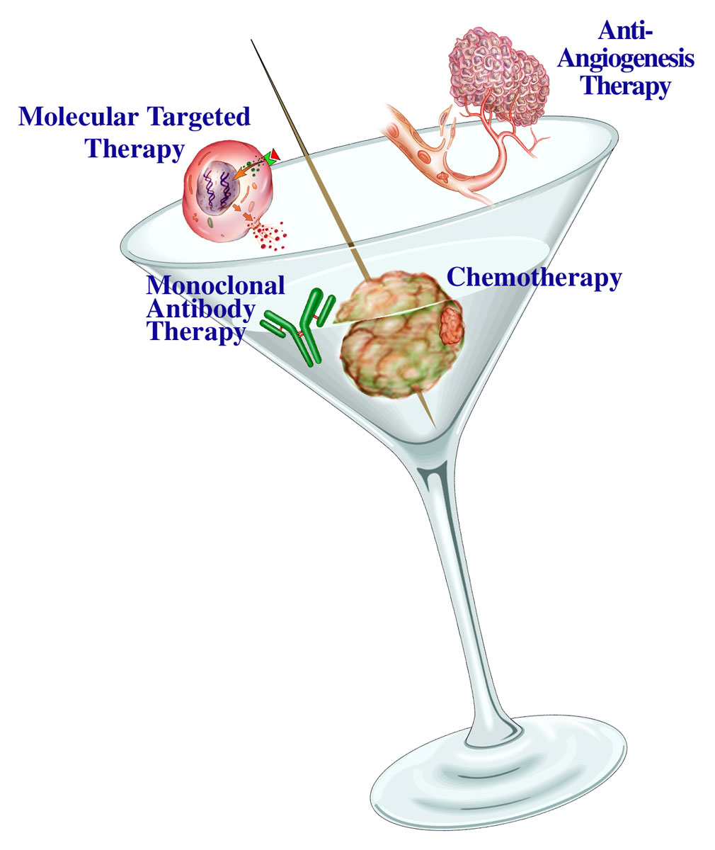


Conclusion
In 2024, there are more and more tests to be performed in lung carcinomas
  Morphological tests (IHC)
  Non morphological (Molecular) tests
  Artificial Intelligence (AI tomorrow) !!!
How will we cope with this rising number of tests ?
  We need to train more pathologists in morphology
  and molecular pathology !
  But here you are, in this great congress in Belém thanks to the
Immunotherapy
Adapted from Roy HERBST
Anti-cancer cocktail of the XXIst century

Slide 41
obrigado!

